Slide 1
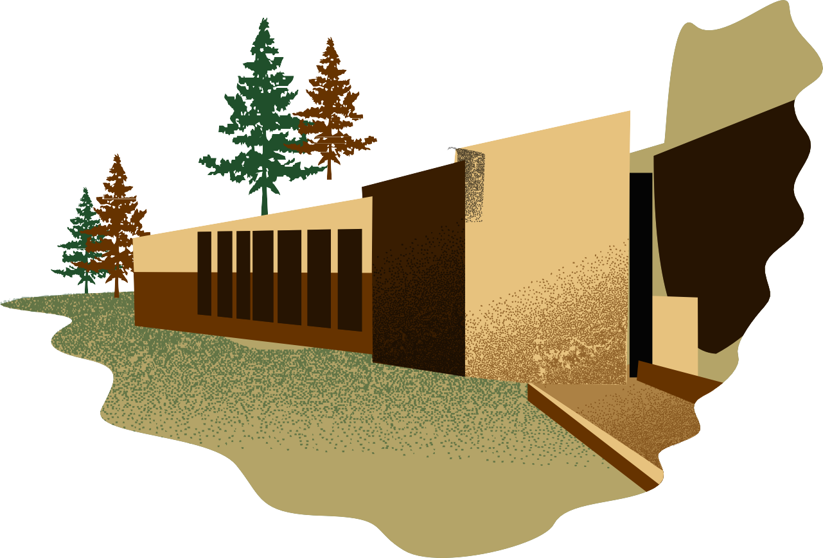
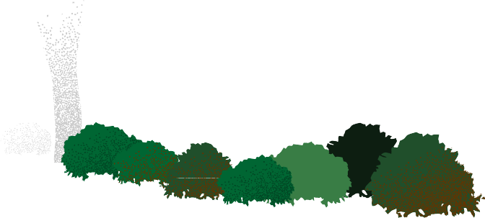
GIST: Grassroots Level Institutions Strengthening and Transformation for Climate Action
Empowering communities to lead sustainable development and climate action.

Slide 2
About CRISP
The Centre for Research in Schemes and Policies (CRISP) is an initiative by a group of (10) civil servants, who worked at the level of Secretary to
Government of India, to help designing/redesigning/evaluating
the State and Central Governments in the schemes/policies in social sector.
Currently, CRISP is working with 10 state governments in various sectors prioritising the Sustainable Development Goals (SDGs) 1, 2, 3, 4, 5 and 16.
The Grassroots Level Institutions Strengthening and Transformation for Climate Action is supported by Padraka Foundation, a.k.a Living Landscape (Common Ground Initiative).

Slide 3
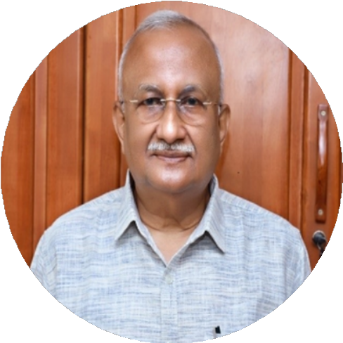
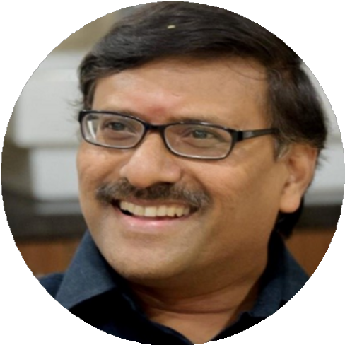
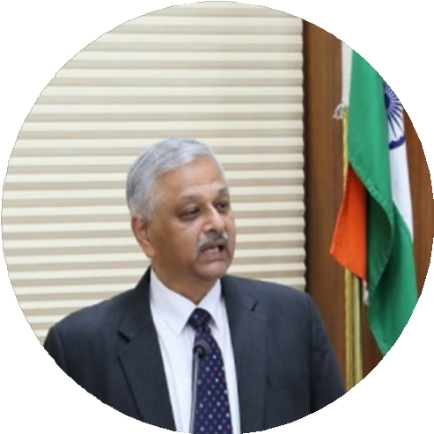
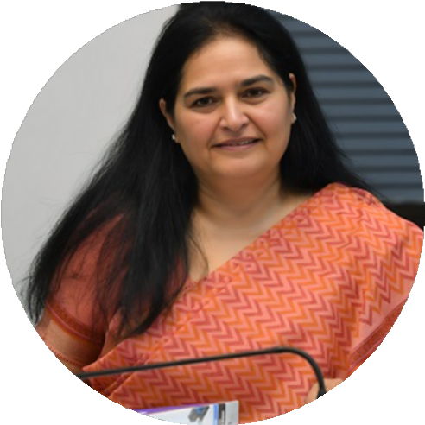
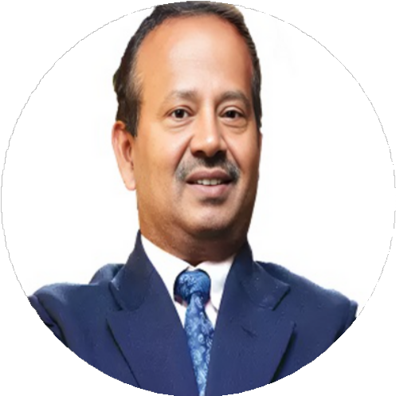
Mentors for GIST
S M Vijayanand IAS – 1981
R. Subrahmanyam IAS – 1985
Dr. C CHANDRAMOULI IAS – 1985
Usha Sharma IAS – 1985
Sri Nagendra Nath Sinha IAS – 1987

Slide 4
Strengthening Grassroots Institutions for Climate Action
Grassroots institutions play a crucial role in addressing the pressing challenges of climate change and environmental degradation in rural communities.
02
Grassroot Level Institutions
Schools, Anganwadi centers and Primary Health Centres and other institutions that play a pivotal role in service delivery and awareness raising
Gram Panchayats
Constitutional bodies responsible for local governance, with a mandate to tackle climate change and environmental issues.
Community Based
Community based organisations
Organisations
that provide critical support and empowerment enabling communities to address climate challenges
01
03
By fostering collaboration and leveraging the strengths of local governance bodies, community organizations, and essential service providers, we can develop integrated solutions to build climate resilience and promote sustainable development.

Slide 5
COMPONENTS OF GIST
GP-SHG
Convergence
Operationalising PESA
Enhancing FRA Implementation
Usage of Commons
Localisation of SDGs

Slide 6
01
02
03
Promote policy coherence
Align grassroots organizations for effective GPDP and VPRP implementation, ensuring coordinated local development.
Translate policies into context-specific actions by building capacity and issuing tailored guidelines and training modules.
and convergence
across climate,
rural domains
natural water,
resource,
and
development
through stakeholder-
informed tweaks.
GIST’s
Approach
04
05
06
Maximize funding for community, nature, and climate by pooling government and private resources, including CAMPA, DMF, CSR, and ESG
Leverage technology and market incentives to foster sustainable practices through data-driven planning and resource mapping.
Facilitate cross-state writeshops to encourage policy innovation, collaborative learning, and strengthening of policy-practice links

Slide 7
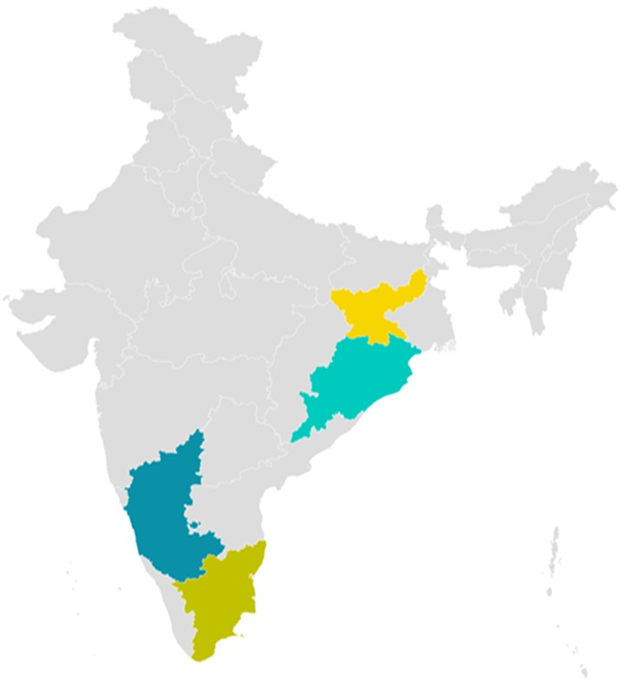
STATES FOR PILOT IMPLEMENTATION
KARNATAKA
ODISHA
JHARKHAND
TAMIL NADU

Slide 8
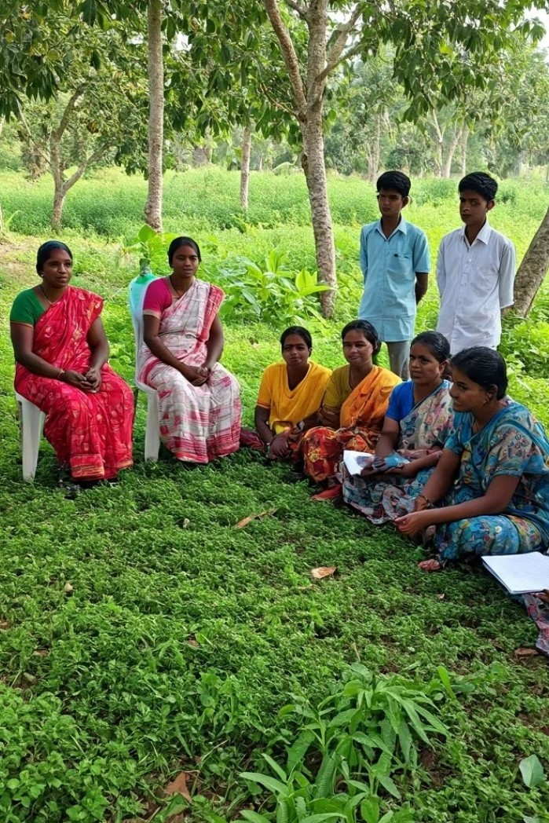
Strengthening Gram Panchayat
- CBO Convergence
Foster SHG-GP collaboration to strengthen local governance and community development.
Empower SHGs in decision-making to address the needs of women and marginalized groups.
Align SHG initiatives with GP programs for resource management and livelihood generation.
Support socio-economic development through coordinated SHG and GP efforts.
Enhance implementation of government schemes for sustainable and inclusive grassroots outcomes.

Slide 9
Theory of change - Strengthening the Gram Panchayat - CBO Partnership
Inputs Activities Outputs Outcomes Impact
Funding: Financial resources from government and non-government sources.
Expertise: Knowledge and experience from CRISP & Living Landscape members and other experts.
Government Collaboration: Partnerships with local and state government bodies.
Community Engagement: Participation and input from local communities and grassroots institutions.
Studying Existing Guidelines on Strengthening Local Institutions
Initial Consultation Meeting
Field Visits to Local Institutions
Draft Action Plan for Institutional Strengthening Writes Shop with Key Stakeholders Pilot Implementation in Selected Institutions Preparation of Initial Report and finalisation Workshops for Implementation and Skill Enhancement Ongoing Support and Handholding
Status Report on SHG-Gram Panchayat Partnership Strengthening, Consultation report along with field visit report.
Draft Action Plan for SHG-Gram Panchayat Partnerships, Guidelines for SHG- Gram Panchayat Partnership & Pilot Implementation Plan Government Order on SHG-GP
Convergence Training Module for GP-CBO Partnership. Trained Personnel Enhanced skills and knowledge among local institution representatives.
SoP on ongoing support and hand- holding strategy and scaling up.
Enhanced Service Delivery & Greater Institutional Collaboration:More efficient and targeted services to community members , leading to Improved coordination and partnership among local institutions.
Increased Public Trust: Higher levels of trust in local institutions due to transparency and accountability.
Strengthened
Governance: More practical and inclusive governance practices at the grassroots level.
Improved Livelihoods
through Community based organisations involved in Value Chain Activities .
Improved Common
Utilizations under community-led management
Sustainable Community Development: Long- term improvements in living standards and community well-being. Reduced Inequality: More equitable access to services and opportunities for all community members. More vital Institutions: Robust, accountable, and inclusive institutions that address local needs.
Improved Standard of
Living among the Communities Reduced climate vulnerability among the Communities Improved Climate
Actions at Village level
by the Communities

Slide 10
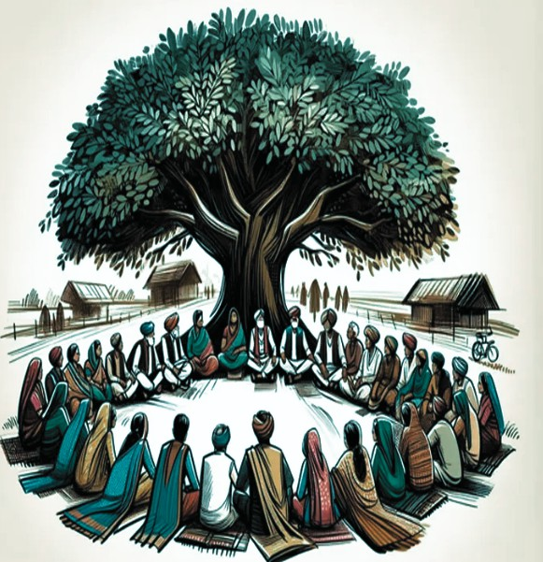
Operationalising Panchayats Extension to Scheduled Areas Act (PESA)
Support State government to focus on effective operationalization of PESA to empower tribal communities in Odisha and Jharkhand.
Enhance tribal representation in decision-making to uphold traditional cultures and rights.
Promote sustainable management of natural resources through PESA implementation.

Slide 11
Theory of change - Operationalising Panchayats Extension to Scheduled Areas
Inputs Activities Outputs Outcomes Impact
Funding: Financial resources from government and non-government sources.
Expertise:
Knowledge and experience from CRISP & Living Landscape members and other experts.
Government
Collaboration: Partnerships with local and state government bodies.
Community
Engagement: Participation and input from local communities and grassroots institutions.
Understanding current situations including study of acts and rules Stakeholder Consultations Support State Government in finalising/improving PESA
Support State Government in Securing RGSA Funding for PESA Areas Implementation in selected Gram Panchayat
Module
Development Hand Holding for Scaling Up
Status Report on PESA, Consultation report along with field visit report.
Draft Action Plan for Operationalising Panchayats Extension to Scheduled Areas Act (PESA)
Identification of blocks for pilot implementation Training Module for Operationalising Panchayats Extension to Scheduled Areas Act (PESA)
Trained Personnel Enhanced skills and knowledge among local institution representatives.
SoP on ongoing support and hand- holding strategy and scaling up
Enhanced Service Delivery & Greater Institutional Collaboration:More efficient and targeted services to community members , leading to Improved coordination and partnership among local institutions.
Enhanced tribal representation in decision-making & ensure sustainable management of natural resources at the village level.
Increased Public Trust: Higher levels of trust in local institutions due to transparency and accountability.
Strengthened Governance: More practical and inclusive governance practices at the grassroots level.
Sustainable Community Development: Long- term improvements in living standards and community well-being. Reduced Inequality: More equitable access to services and opportunities for Tribal community members. More vital Institutions: Robust, accountable, and inclusive institutions that address local needs.
Improved Standard of Living among the Communities Reduced climate vulnerability among the Communities Improved Climate Actions at Village level by the Communities

Slide 12
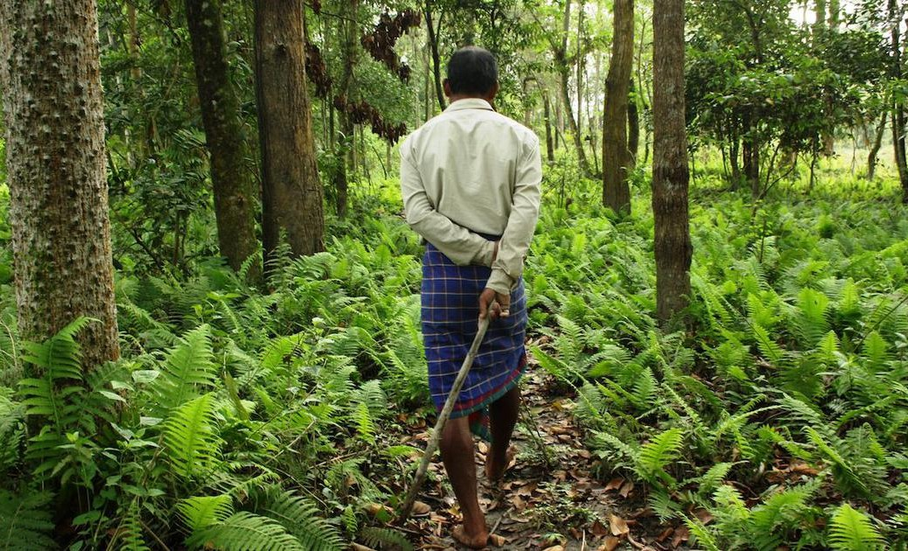
Enhancing Implementation of Forest Rights Act(FRA)
Enhance quality of Forest Rights Act (FRA) implementation to empower tribal communities in Odisha and Jharkhand.
Empower communities to secure individual and community rights over inhabited forest areas.
Support state governments in streamlining FRA filing processes for effective claims and approvals.

Slide 13
Theory of change - Enhancing Implementation of Forest Rights Act
Inputs Activities Outputs Outcomes Impact
Funding: Financial resources from government and non-government sources.
Expertise: Knowledge and experience from CRISP & Living Landscape members and other experts.
Government
Collaboration: Partnerships with local and state government bodies.
Community
Engagement: Participation and input from local communities and grassroots institutions.
Study of the existing framework a comprehensive desk study to analyse existing guidelines and frameworks related to implementing FRA
Training Community Resource Persons on knowledge and skills for effectively supporting the filing of rights under the Forest Rights Act (FRA)
Draft Action Plan on Pilot Implementation.
Write shop with Key Stakeholders Module Development
Current Status Report Implementation of FRA
Draft Action Plan for training Community Resources Persons on FRA Identification of blocks for pilot implementation Training Module on enhanced implementation of FRA
Trained Personnel Enhanced skills and knowledge among local institution representatives.
Module for successful implementation of of FRA.
Enhanced Service Delivery & Greater Institutional Collaboration:More efficient and targeted services to community members , leading to Improved coordination and partnership among local institutions.
Enhanced tribal representation in decision-making & ensure sustainable management of natural resources at the village level.
Increased Public Trust: Higher levels of trust in local institutions due to transparency and accountability.
Strengthened Governance: More practical and inclusive governance practices at the grassroots level.
Sustainable Community Development: Long- term improvements in living standards and community well-being. Reduced Inequality: More equitable access to services and opportunities for Tribal community members. More vital Institutions: Robust, accountable, and inclusive institutions that address local needs.
Improved Standard of Living among the Communities Reduced climate vulnerability among the Communities Improved Climate Actions at Village level by the Communities

Slide 14
Planning for identifying, protecting, and regenerating Commons
Protect village
commons to sustain rural
environmental
l.ivelihoods and promote stewardship.
Commons provide essential services (fodder, fuel, water, agricultural inputs) critical for local communities and vital for marginalized groups, who depend on shared resources for survival. Ensure sustainable management of these to prevent resource depletion, reduce conflicts, and ensure equitable access.
Contribute to biodiversity conservation and climate resilience through commons preservation.
Strengthen community economic well-being commons.
cohesion and by protecting
socio- village

Slide 15
Theory of change - Planning for identifying, protecting and regenerating Commons
Inputs Activities Outputs Outcomes Impact
Funding: Financial resources from government and non-government sources.
Expertise: Knowledge and experience from CRISP & Living Landscape members and other experts.
Government
Collaboration: Partnerships with local and state government bodies.
Community
Engagement: Participation and input from local communities and grassroots institutions.
Review of Existing Laws and Regulations
Field Visits for Identification of Implementation Challenges Pilot
Implementation in Selected Gram Panchayats
Study of Legal Procedures for Eviction and Land Rights Generating Constructive
Community Action through SHGs and MGNREGA for Land Protection Ongoing Support and Handholding for Commons Regeneration Documentation and Scaling Up Recommendations
Status Report Existing Laws & Regulation, legal Procedures for Eviction & Land Rights , Consultation report along with field visit report.
Government Order on Commons Development Draft Action Plan for Regenerating Commons and MGNREGA fund utilisation & Generating Constructive Community Action towards Protecting Commons.
Training Module for Planning for identifying, protecting and regenerating Commons. SoP on ongoing support and hand-holding strategy and scaling up & Recommendation
Improved optimum utilisation of commons at the village level Improved Climate Actions at Village level by the Communities Increased community participation in decision making process with respect to utilisation of commons Improved MGNREGA Fund
utilisation for protection and regeneration of Commons
Sustainable Community Development: Long-term improvements in living standards and community well-being.
Reduced Inequality: More equitable access to services and opportunities for all community members.
Improved
Standard of Living among the Communities Reduced climate vulnerability among the Communities

Slide 16
Localisation of Sustainable Development Goals
Localise SDGs through a community- based approach to achieve timely results in villages.
Build capacities of communities, led by Gram Panchayats, in collaboration with SHGs and other CBOs.
Engage Higher Educational Institutions to support village development via Unnat Bharat Abhiyan and Focused Block Initiatives.
Foster partnerships at the village level to drive sustainable development through local institutions and initiatives.

Slide 17
Theory of change - Localization of Sustainable Development Goals
Inputs Activities Outputs Outcomes Impact
Funding: Financial resources from government and non-government sources.
Expertise: Knowledge and experience from CRISP & Living Landscape members and other experts.
Government
Collaboration: Partnerships with local and state government bodies.
Community
Engagement: Participation and input from local communities and grassroots institutions.
Studying Existing Guidelines on Localization of Sustainable Development Goals (SDGs)
Consultative Meeting
with Relevant Stakeholders
Field Visits for Ground Situation
LSDG Report with an
action plan Consultation with stakeholders on the Action Plan
Pilot Implementation in
Selected Panchayats Workshops for Implementation and Skill Enhancement
Ongoing Support and
Handholding for Localization of SDGs Documentation and Scaling Up Implementation Workshops, Support, and Evaluation
Status Report on Localisation of SDGs along with field visit report.
Draft Action Plan for Localization of SDGs, Guidelines for Localization of SDGs & Pilot Implementation Plan
Government Order on Localisation of SDGs Training Module for Localization of SDGs.
Trained Personnel Enhanced skills and knowledge among local institution representatives.
SoP on ongoing support and hand- holding strategy and scaling up & Monitoring and Evaluation Framework
Enhanced Service Delivery & Greater Institutional Collaboration:More efficient and targeted services to community members , leading to Improved coordination and partnership among local institutions.
Increase in Sustainable solution oriented approach at the grassroot level Reduction in Human developmental challenges(Education, health & Nutrition) like MMR, IMR, drop out, Malnourishment, etc Increase in Human developmental indicators (Education, Health and Nutrition) SLO, enrollment ration, growth monitoring, ANC, PNC, etc
Sustainable Community Development: Long-term improvements in living standards and community well- being.
Reduced Inequality: More equitable access to services and opportunities for all community members.
More vital
Institutions: Robust, accountable, and inclusive institutions that address local needs. Improved Standard of Living among the Communities.

Slide 18
Studying Existing Guidelines:
Review current guidelines
and practices related to local institutions and CBOs/SHGs.
Initial Consultation Meeting:
Engage with officers and
stakeholders to understand dynamics and identify
collaboration areas.
Field Visits to Local Institutions:
Conduct visits for firsthand
insights into practices, challenges, and opportunities.
Draft Action Plan for Institutional
Strengthening:
Develop a detailed action plan based on best
practices and stakeholder
inputs.
Writeshop with Key Stakeholders:
Organize sessions to create
a convergence model and strategies for SDG achievement.
Pilot Implementation in Selected
Institutions:
Test strategies in selected
villages and adjust based on real-world feedback.
Steps in implementing GIST
Preparation of Initial Report and
Finalization:
Document findings, refine strategies, and plan for scaling up.
Workshops for
Implementation and Skill Enhancement:
Guide and train
representatives for effective collaboration and management.
Ongoing Support and Handholding:
Provide continuous
support, troubleshooting, and additional training.
Monitoring and
Evaluation (M&E):
Establish an M&E framework to track progress, assess
effectiveness, and make
adjustments.

Slide 19
Dr. Vijaya Raghavan
S Govind
GIST TEAM
Prakash Palanivel
Abiya Jose
Gaurav Nayak

Slide 20
THANK YOU

