Slide 1
AP Leadership in Education: An Action Plan
Under CRISP and Govt of AP partnership

Slide 2
CRISP MoU with Govt. of AP
Date: 27th Oct 2022
Focus: School Education

Slide 3
Main Projects in the MoU
To develop definitive and robust strategies for transition to CBSE for 1000 schools.
To develop strategies for effective operationalization of Foundational Schools.
To recommend the best package of practices in operationalising digital education.

Slide 4
Project 1: CBSE transition of 1000 schools
2022–2023
To bring more rigour and standardisation in the learning ecosystem of the 1000 high schools that have been affiliated to CBSE during academic year 2022 – 23.
2024–2025
To design a definitive strategy and robust operational plans to help the students make the grade and come out successful in the board examination 2024 – 25.
To stand as the best at the National level

Slide 5
Current Scenario of CBSE Schools
1000 CBSE SCHOOLS
4,39,595 Students
18,049 Teachers
268 do not have a Science Lab
279 does not have a Library
546 have NO Computer Lab
NO School has Art Room
S. No. | Management Category | CBSE Affiliated Schools in 2022-23
1. | KGBVs | 335
2. | APMS | 154
3. | APREIS | 38
4. | ZPHS | 215
5. | APTWREIS | 49
6. | Municipal | 28
7. | APSWREIS | 157
8. | MJPAPBCWRIS | 24
 | TOTAL | 1,000
Additional Class Rooms under construction - Nadu-Nedu PII & PIII
Teachers with PG 13,685; Without PG 4365 – 25% to be replaced with Qualified Teachers in CBSE affiliated schools
(UDISE 2022-23)

Slide 6
4-Fold Interventions
3
4
1.
2
Administrative
Academic
Teachers
Students
Affiliation Requirements
Convergent ways of working
School Twinning
State CBSE Portal and School Websites
Annual Planners [Instructional material - Bridge Course, Teacher Guides]
Structured Pedagogy
Teacher Deployment
Trainings for Head Teacher and Subject Teacher
Mentoring of Teachers
Student Mentoring
Counselling Sessions for Students

Slide 7
1.i. Affiliation Requirements
A simple survey was prepared for Head Teachers of 1000 schools related to Basic Affiliation Requirements of CBSE.
Survey deadline is end of April.
870 responses received.
Based on the responses, CRISP will submit a report with budget friendly suggestions to meet the basic affiliation requirements.

Slide 8
1.ii. Convergent Approach
1000 Schools
8 Different Managements
Standard Operating Procedures for Convergent ways of working
Lead Team directly under Commissioner of School Education
Special CBSE Cell under each management
Fortnightly meetings for monitoring progress
WhatsApp Groups for Information sharing, tracking progress

Slide 9
1.iii. School Twinning
The 1000 affiliated schools are new to the CBSE pattern and curriculum.
Best practices sharing, hand-holding through this transition process.
PEDAGOGY:
Approx. 350 + other CBSE schools
Categorize 1000 schools in 4 categories based on their performance.
Twin 4 schools from each category with the master schools.
CRISP will prepare a report after categorization of 1000 schools, the prospective ‘Twin Schools’. The report will observe the nature of schools (residential), location, etc.

Slide 10
1.iv. State CBSE Portal and School Websites
ADMINISTRATIVE
ACADEMIC
STUDENTS RELATED
Government Orders
Guidelines for Teachers
Trainings Colander
Dashboards & Statistics
Infrastructure, etc.
Annual Planner
Structured Pedagogy content
Special Courses
Supplementary Material
Teacher – Pupil Ratio, etc.
Enrolment Statistics
Progress Reports
Activities done
Achievements
Admission Details, etc.
Examination Registration

Slide 11
2.i. Annual Planner (Instructional, Bridge Courses)
Commencement of Academic Session “1st April to 31st March” | Daily Working Hours. | Daily Lesson Plans
Blend of curricular, co – curricular and extra – curricular activities | Instructional Material Development (English) | Teacher Training Duration
Bridge Course Preparation and Duration | Regular Review Meetings by HMs. | Regular Parent-Teacher Meetings
List of Holidays | Time Tables | Examination, etc.
CBSE focus on “Guided Teaching” - Annual Planner is a necessity.
Better Learning Outcomes
CRISP will facilitate workshops for Annual Planner development.
JNV Model - Residential Schools
KV Model - Regular Schools

Slide 12
2.ii. Structured Pedagogy
Work with SCERT
Select Team of Teachers
Orientation on preparation of Structured Pedagogy for Subject Teachers.”
TECHNIQUES
TOOLS
TRAININGS

Slide 13
3. Teacher Related
HEAD TEACHERS
Academic
Affiliation,
Management,
IT, etc.
3.i. Teacher Deployment: As per CBSE Qualification, Pupil Teacher Ratio, Staffing Pattern, etc.
3.ii. Teacher Training (18,049) – For both Head Teachers and Subject Teachers based on their requirements.
SUBJECT TEACHERS
NEP Mandated: Continuous Professional Development
Online Trainings: On CBSE Portal
Specific Training: centre of Excellence
MENTORING
Incentives to perform better: exposure Trips, 100 Teachers fellowship

Slide 14
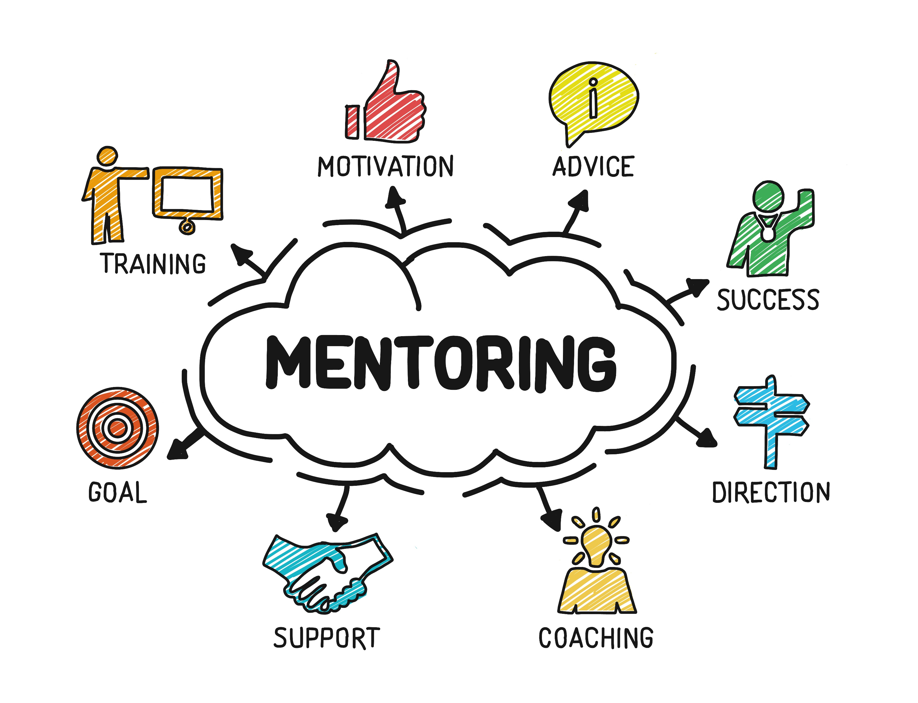
4.i. Student Related
Classroom Based Assessments (by Education Initiative) Data Analysis and Categorization of Students.
Based on the data analysis, Targeted Remediation would be done, “One-on-One Mentoring”.
Further, supplementary material would be provided to the students in need.

Slide 15
4.ii. Counselling Sessions
“More than the difficulty of examination it is the fear of the CBSE Board Examination.”
To motivate and prepare students mentally to actively engage with learning & examination; both “Career” and “Mental Health” counselling is needed.

Slide 16
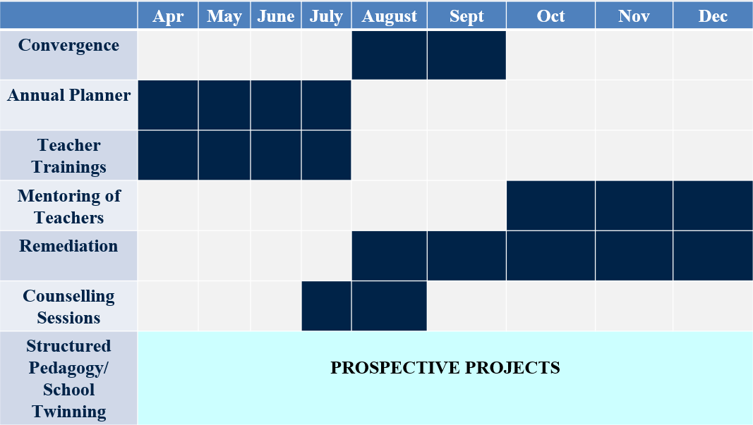
Expected Timeline

Slide 17
Project 2: Foundational schools
Objective: Universalize access to quality ECE

Slide 18
OBJECTIVES
Strategy for universalising access to pre-school education
Suggest ways to have trained teachers for pre-primary education
Convergence of ICDS and School Education for delivering quality pre-primary education
Explore the scope of technology-based interventions for Early Childhood Care and Education
Roadmap for the regulation of pre-school education in the State

Slide 19
STRATEGIES FOR INTERVENTION
1. POLICY INTERVENTIONS -
1.1
1.2
1.3
1.4
1.5
1.6
Ensure dedicated preschool teachers in the Foundational Schools
Creating a cadre of preschool teachers
Streamline enrolment age across AWCs and schools
Comprehensive regulation of ECE/ preschool education delivery
Building PSE Teacher Training capacity in the State
Plan for Infrastructure provision

Slide 20
STRATEGIES FOR INTERVENTION
2. PROGRAMMATIC INTERVENTIONS -
2.1
2.2
2.3
2.4
Build salience for quality ECE, strengthen caregivers’ role and improve community involvement in ECE
Technological ECE Interventions – Comprehensive Online ECE Portal
Strengthen classroom inputs in-line with global best practices and provide more and better support to teachers
Establishing a robust system of monitoring and evaluation

Slide 21
1. Ensure dedicated pre-school teachers (PST)
Mandatory Internship for students of D El Ed
Optimise the existing PSTs through rationalisation
Identify, train and post select AWW as PSTs
(relaxations in age)
Redeploy
willing SGTs as PSTs
Intensive mentorship support to the PST
Relaxation of age criteria up to 35 years to enable experienced AWWs to become PSTs

Slide 22
1.2. Create a cadre of pre-school teachers
i. Development of appropriate recruitment rules and guidelines to create a cadre of PST
iii. Conversion of a certain number of surplus SGT posts into PST posts with a scale of pay
ii. Creation of a career path for qualified AWW

Slide 23
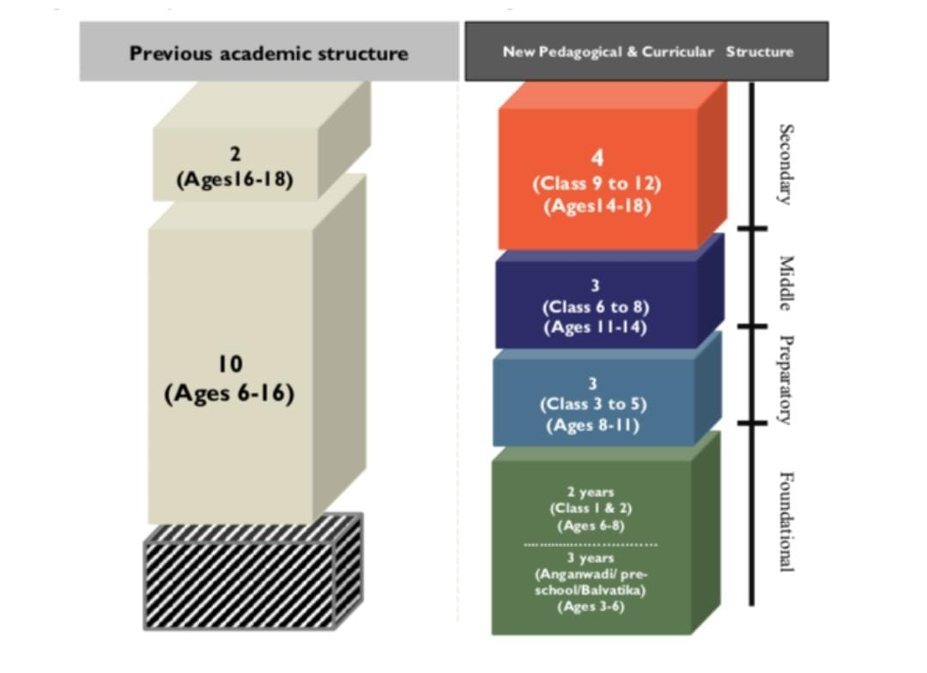
1.3. Streamline enrolment age across AWCs and schools
Streamlining entry age for PP1, PP2, Preparatory Grade 1 and Grade 2 as per NEP guidelines -
3 to 4 Years – Anganwadi / PP1
4 to 5 Years – Anganwadi / PP2
5 to 6 Years – Balavatika
6 to 7 years – Grade 1
7 to 8 years – Grade 2

Slide 24
1.4. Comprehensive regulation of ECE/ preschool education delivery
i
A State Steering Committee and a State Academic Committee as the highest policy making body
A Foundation Schools Board to be set up under the Department of School Education
A dedicated, Mandal-level post of Supervisor or Assistant-In-Charge of Pre School Education
iii
ii

Slide 25
1.5. Building Pre-School Teacher Training capacity in the State
Strengthening the DIETs -
Study the scope for and introduce credit based courses in Diploma in Pre School Education.
Two year Pre-primary Teacher Education Course to be started in DIETs.
One year Diploma and 6 months Certification courses, which AWWs can complete.
Curriculum revision and awareness-building of the Nursery Teacher Training (NTT) in Intermediate Colleges.

Slide 26
1.6. Plan for Infrastructure provision
A Detailed Project Report which includes -
Survey to identify infrastructural gaps
Strategies to ensure provision of befitting infrastructural facilities
Monitoring mechanism to ensure proper utilisation of TLM provided

Slide 27
2.1. Build salience for quality ECE and strengthen caregivers’ role
I. EDUCATE
State wide communications outreach for awareness building among parents
Strategies -
Creating a short video/film that can be showcased in movie theatres.
II. CONNECT
Involve parents in early learning through targeted outreach.
Strategies –
Learning month along with Poshan Maah
Mega ECE PTMs

Slide 28
2.1. Build salience for quality ECE and improve community involvement in ECE
Leverage Community organisations and local governance bodies -
Community and community organisations like SHGs -
i. Volunteering
ii. Cultural programmes
Local governance bodies (urban and rural)
i. Identifying needs of children
ii. Ensuring quality infrastructure
iii. Awareness building and ensuring enrolment
iv. Regular monitoring

Slide 29
2.2. Technological ECE Interventions – Comprehensive Online ECE Portal
Establishment of a Comprehensive Online ECE Portal
PARENTS AND
STUDENTS
SCHOOL ADMINSTRATORS AND OWNERS
PRE-SCHOOL TEACHERS AND ANGANWADI WORKERS
Tracking student learning outcomes
Rules and guidelines
Lesson plans
Teaching Learning Material
Parental communications
Registration modules
Training modules
Testing & Certification Module

Slide 30
2.3. Strengthen classroom inputs in-line with global best practices and provide better support to teachers
i. Structured Pedagogy
ii. Ensuring Continuous Professional Development of PSTs
iii. Dedicated mentor cadre
iv. Convergence workshops between PSTs and Primary School Teachers for knowledge sharing
v. Monthly observation
vi. Spot assessments
vii. Transition to Grade 1 - Designing modalities for introducing Preparatory Class 1/ Balavatika based on the NIPUN Bharat Guidelines

Slide 31
2.4. Monitoring and Evaluation Framework for ECE
Collaborate with PRATHAM & other partners
Review M & E parameters and methodologies
Establish a framework for monitoring and review of critical indicators
Learning Outcomes
Student enrolment and attendance
FLN Basics
Teacher performance
Student learning
Teacher Preparation
Centre Performance
Registration and Administration

Slide 32
EXPECTED OUTCOMES
School Readiness
Smooth transition to FLN
Closer convergence between DoSE and WCD
Quality ECE delivery in the State

Slide 33
EXPECTED TIMELINES (to be confirmed after discussion with GoAP)
SUB-PROJECTS | MONTH
 | Apr | May | Jun | Jul | Aug | Sep | Oct | Nov | Dec
Policy Note for ensuring designated PSTs
Policy Note recommending creation of PST cadre
Streamlining enrolment age
Mandatory Internship guidelines for D El.Ed students
Formation of a Foundational School Board within the DoSE
Infrastructure Provisioning
Building Pre-School Teacher Training Capacity in the State
Monitoring and Evaluation Framework
Online ECE Portal
Build salience for quality ECE and strengthen caregivers’ role | PROSPECTIVE PROJECT - 2024
Build salience for quality ECE and improve community involvement | PROSPECTIVE PROJECT - 2024
Strengthening classroom inputs | PROSPECTIVE PROJECT - 2024

Slide 34
Project 3: Digital Education
Maximising the utilisation of devices and LMS
Strengthen the basic teacher- pupil transaction using EdTech solutions.
Capacity building to teachers
Periodical evaluation of teacher performance

Slide 35
Redefining Scope
How to further improve these innovations to achieve the desired outcomes?
How to effectively implement digital learning innovations?
How effective were the digital learning solutions in improving student learning outcomes?

Slide 36
OBJECTIVES
To assess the efficacy and effectiveness of the recent digital initiatives undertaken in the State.
To suggest digital interventions for ECE and
effective delivery of preschool education in AP State.
To motivate teachers to effectively utilise EdTech resources and adopt technology in their pedagogy.
To deepen the use of EdTech tools to enhance student learning outcomes in the 1000 CBSE schools.
To provide additional suggestions
To develop appropriate LMS for Early Childhood
Additional Suggestions

Slide 37
Concurrent evaluation of digital education initiatives
Robust research methodology for selection of schools and stakeholders
Undertake a survey of randomly selected 5000 schools where TABs are distributed to understand the functionality, quality of content, usage, efficacy and gaps in the delivery of the initiative.
Study how the various EdTech initiatives are being implemented at the school level
Identify areas for strengthening
Recommend modalities to further strengthen and support GoAP to review and redesign appropriate policies/schemes.
Stratified/random sampling techniques
Qualified and experienced Research Assistants/Associates to administer the questionnaire, conduct Focus Group Discussions (FGDs), Key Interviews and to conduct the survey
Development of a comprehensive Questionnaire

Slide 38
TIMELINE (to be confirmed after discussion with GoAP)
 | Stages | Month
 |  | Feb | Mar | Apr | May | Jun | Jul | Aug | Sep | Oct | Nov | Dec
Concurrent evaluation of TABs and content | Design of Survey
 | Conduction of the Survey
 | Data analysis
 | Preparation of Report

Slide 39
Development of comprehensive EdTech support system for Foundational Schools
App based daily lesson plans
Comprehensive Portal for Foundational Schools that facilitates all ECE related matters
Development of appropriate Learning Management System (LMS)
Work with LFE and Pratham for appropriate modification of the TEACH Tool to suit quality ECE delivery
Recognition and rewards system to motivate pre-school teachers to effectively utilise digital education tools
Preschool education teacher guides, Structured pedagogy for delivery of activities
Monitoring dashboards, tracking student learning outcomes, teacher lesson planning, lesson plans and schedules, guidance for parents, parental communication

Slide 40
TIMELINE (to be confirmed after discussion with GoAP)
 | Stages | Month
 |  | Feb | Mar | Apr | May | Jun | Jul | Aug | Sep | Oct | Nov | Dec
Ed-Tech in Foundational Schools | Discussions with the Tech team and Pratham
 | Begin design of the portal/ Explore funding options/ Development and deployment
 | Portal completion and launch
 | Discussions with the Tech team and Pratham on TEACH tool
 | Work on modification of TEACH tool
 | TEACH tool Pilot

Slide 41
Experience sharing and appreciation sessions for teachers
To identify highly motivated teachers as master trainers for every subject
Experience sharing and appreciation sessions
Fun get-together and unwinding sessions with relevant games and leisure activities
Recognition and Rewards system including Teacher Fellowship for 100 Teachers
To encourage peer learning among teachers and improve quality of teaching-learning processes in the schools.
- To make them comfortable with the use of technology
- fun experience
- organised at the block level.

Slide 42
TIMELINE (to be confirmed after discussion with GoAP)
 | Stages | Month
 |  | Feb | Mar | Apr | May | Jun | Jul | Aug | Sep | Oct | Nov | Dec
Informal Teacher Motivation Session / experience sharing session | Design of sessions
 | Mapping of Master Volunteers
 | Talks with Master Volunteers and BEOs for planning of sessions
 | Redesigning the Sessions based on inputs and suggestions
 | Teacher Motivation Session / experience sharing session – 1 (as it is the start of the academic year, a pilot can be first conducted in one district).
 | Session - 2
 | session - 3
 | Evaluation of the effectiveness of the sessions

Slide 43
Deepen the use of EdTech tools to enhance student learning outcomes in the 1000 CBSE schools
CBSE Portal
Active access of LMS and dashboards
Implementation of Personalised Adaptive Learning (PAL) application
Student IT clubs
Pilot for introducing new skills like coding and computer programming
Recognition and rewards system to motivate teachers to effectively utilise digital education tools
Fine tune Teach Tool

Slide 44
State CBSE Portal, School Website aligned with OASIS – Online Affiliated School Information System SARAS - School Affiliation Re-Engineered Automation System, etc.
ADMINISTRATIVE
ACADEMIC
STUDENTS RELATED
Government Orders
Guidelines for Teachers
Trainings Colander
Dahsboards & Statistics
Infrastructure, etc.
Annual Planner
Structured Pedagogy content
Special Courses
Supplementary Material
Teacher – Pupil Ratio, etc.
Enrolment Statistics
Progress Reports
Activities done
Achievements
Admission Details, etc.
Examination Registration

Slide 45
EXPECTED OUTCOMES
1
2
3
4
5
Evidence based policy design, implementation and mid-course correction of the digital education initiatives
Enhance teacher usage of EdTech resources and data systems to make instruction more effective
Easy access to information, improve communication, increase engagement and leverage technology to improve efficiency and operations.
Motivation through appreciation, improving pedagogy and classroom transaction, increased confidence to adopt existing and new technologies.
Improved quality of teaching–learning and student learning outcomes in1000 CBSE schools
To develop appropriate LMS for Early Childhood
Additional Suggestions

Slide 46
MONITORING AND EVALUATION
Re-evaluation of the Ed-tech initiatives in the year 2024-2025 to check progress and improvement.
Monitoring by Vidya Samiksha Kendra (Command and Control Centre)
Monthly meetings on Digital education adoption and utilisation at the Headmaster, BEO and DEO levels.
Quarterly reviews with the Commissioner

Slide 47
OTHER SUGGESTIONS FOR CONSIDERATION
EdTech for Extracurricular activities to enable holistic development of children
Interactive sessions can be held across topics such as linguistics, arts and crafts, health and fitness.
Live classes, short certificate courses in synchronous/asynchronous format, etc. can be explored.
Extra support/ mentorship for students by volunteers
This can be done by connecting passionate individuals as volunteer teachers from across the State with the Govt elementary schools by leveraging technology. Live interactive classes can be delivered in the local medium by these volunteers who sign up for a fixed period.
https://www.evidyaloka.org/

Slide 48
Thank You

