Slide 1
CRISP - Rajasthan
Review of ongoing projects

Slide 2
CRISP - GoR: Initial MoU
To conduct a concurrent evaluation of IRGY-Urban
To facilitate the capacity building of frontline LSG functionaries.
To develop a scheme with verifiable parameters for ranking of the ULBs based on their performance in the IRGY-Urban
To assist GoR in setting up of the Rajasthan Social and Performance Audit Authority.

Slide 3
Concurrent Evaluation of IRGY - Urban

Slide 4
Background
The Indira Gandhi Shahari Rozgar Guarantee Yojana was launched in Rajasthan in September 2022 with the objective of providing 125 days of guaranteed wage employment to any family having adults between 18-60 years of age (with a valid Jan Aadhaar/Family ID card) residing in urban areas of Rajasthan.
The progress of the scheme as on 1st September 2023 is given below:
Job cards - 5,84,121
Work demand - 591,596
Registered members - 9,00,029
Sanctioned Works (Total) - 21,149

Slide 5
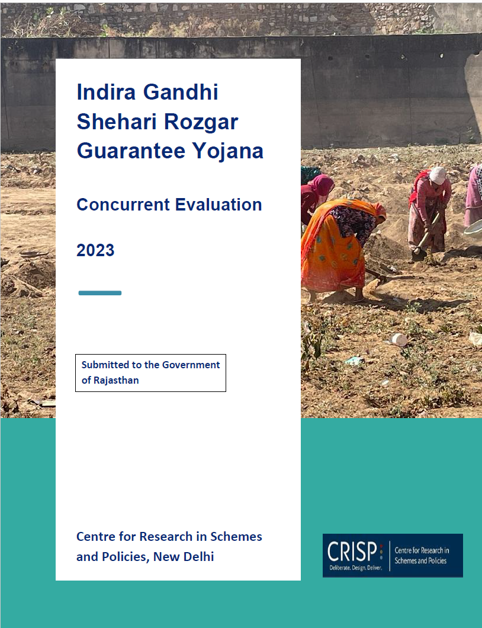
Concurrent Evaluation Report
In February 2023, CRISP released a report of the IRGY concurrent evaluation, detailing the findings from field, best practices from other states and recommendations based on field insights.
The report included recommendations related to:
Enhancing participation in the scheme
Expanding the scope of work
Ensuring timely payment of wages
Facilitating skill development

Slide 6
Kaam Pao Abhiyaan
CRISP, in collaboration with GoR and Suchna Evum Rozgar Adhikar Abhiyaan organized a Kaam Pao Abhiyaan (KPA) across Rajasthan with the objective of ensuring maximum worker participation in IRGY - Urban. A few highlights from KPA are as follows:
KPA was organized in two phases - 19th to 24th February 2023 and 13th to 17th March 2023.
RYMs working in urban areas of the state interacted with approximately 15000 citizens (total number of interactions from both phases).
The first phase of KPA was focused more on spreading awareness about the scheme.
During the second phase of KPA which was more action-oriented, the RYMs reported to have created 1600 job cards, demanded work for around 4000 citizens and registered 300 complaints.

Slide 7
Impact Evaluation of IRGY - Urban
CRISP will conclude the evaluation of IRGY - Urban through an impact evaluation of the scheme. The coverage of the study is as follows:
33 districts
800+ Beneficiaries
42 Urban Local Bodies (ULBs)
Implementing staff at 12+ ULBs

Slide 8
Objectives
To analyse the regional variations in scheme performance
To understand variations in scheme benefits according to the social and economic characteristics of beneficiaries
To understand the utilization of income received from the scheme
To understand the status of provision of basic facilities at worksites
To understand the challenges faced by citizens in accessing the scheme
To understand the challenges faced by officers in successful implementation of the scheme

Slide 9
Methodology
Quantitative
Analysis of administrative data
Household survey
Qualitative
Interviews with implementing officers in 12+ ULBs which have been selected as outliers based on the analysis of administrative data

Slide 10
Timeline
Action Item | Status/ To be completed by
Household Survey | Completed
In-depth interviews | 1st Week of September
Data Analysis | 2nd Week of September
Draft report | 3rd Week of September
Submission of final report | End of September

Slide 11
Concurrent Evaluation of Chiranjeevi Yojana

Slide 12
Background of the scheme
Mukhya Mantri Chiranjeevi Swasthya Bima Yojana (MMCSBY) is being implemented in Rajasthan since 1st May 2021 with an aim to reduce out of pocket expenses for hospitalisation (inpatient care and day care surgeries) for treatment of diseases and medical conditions.
Department of Health and Family Welfare, GoR implements the scheme through the Rajasthan State Health Assurance Agency (RSHAA).
Budget 2023-24: Medical cover under the scheme has been increased from Rs 10 lakh to Rs 25 lakh annually per family

Slide 13
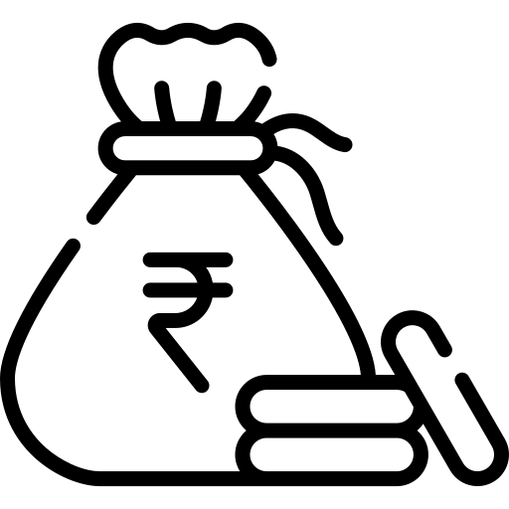
Progress of the scheme
(From 1st May 2021 to 02 March 2023)
1.39 crore registered families
1798 packages
846 government and 922 private empanelled hospitals
34.29 lakh patients treated
66.78 lakh claims submitted
Claim Amount -Rs. 3908.58 crore

Slide 14
Objectives
In collaboration with Health System Transformation Platform (HSTP), CRISP will conduct an evaluation to review:
Current status, processes both technical and operational in the implementation of the scheme
Identify gaps and provide recommendations to enhance scheme implementation and improving provision of Universal Health Coverage (UHC).
Assess the early impact of the scheme on the beneficiaries in terms of key parameters such as out-of-pocket expenditure and mortality.
To evaluate the extent of participation of empanelled hospitals and to develop recommendations for improvement.
To analyse the data (subject to willingness of the state) to identify trends and patterns in claims.

Slide 15
Methodology
Quantitative
Survey of patients admitted in the hospital
Qualitative
Interviews of Swasthya Margadarshaks
Interviews of Hospital Administrators

Slide 16
Coverage of the study
33 Districts
102 Hospitals
500+ Patients
100+ Swasthya Margadarshaks
10+ Hospital Administrators

Slide 17
Timeline
Action Item | Status/ To be completed by
Survey of beneficiaries | 2nd Week of September
In-depth interviews | 2nd Week of September
Data Analysis | 3rd Week of September
Draft report | 4th Week of September
Submission of final report | To be decided

Slide 18
Operationalization of the Gig Workers Welfare Act

Slide 19
Status
In the budget 2023-24, GoR introduced the Gig Workers Welfare Act and announced 200 Crores for constituting a welfare board. Rajasthan will be the first state in India to enact a legislation for the protection of gig workers.
On 10th July 2023, CRISP submitted recommendations for strengthening the Gig Workers Welfare Act.
CRISP Rajasthan and the Labour Department, GoR are currently in the process of discussing CRISP’s intervention in the implementation of the Act.

Slide 20
Capacity building of MG Seva Preraks

Slide 21
Status
In the announcement of the state budget for the Financial Year 2023-24, the Rajasthan Government announced allocating funds to the tune of 25 crores towards establishing 2500 Mahatma ‘Gandhi Pustakalya evam Samvidhan Kendras’ across Rajasthan.
For the overall operations of the ‘Gandhi Pustakalya evam Samvidhan Kendras’, the government will appoint 50,000 ‘Mahatma Gandhi Seva Preraks’.
In the recent meeting with Finance Secretary, GoR on 13th April 2023, it has been discussed that CRISP can support the department in training, monitoring & evaluating the overall work of MG Seva Preraks.

Slide 22
Mehangayi Rahat Camps

Slide 23
Status
Mehangayi Rahat Camps were launched by GoR to provide relief to citizens against rising inflation by linking them to welfare schemes.
The team visited multiple camps across 11 districts of Rajasthan to observe the implementation of these camps.
Recommendations were developed for streamlining the implementation of these camps.

