Slide 1
Karnataka Team
Evaluation of Rural Libraries
Concurrent evaluation of MGNREGA Crèches
Convergence of Gram Panchayats and Self Help Groups
Gram Arogya (Public Health)
Summary of projects on hand
Presented at the Governing Body Meeting September 5, 2023
Promotion of Sports activities in Gram Panchayats
Institutional strengthening of Social Audit Unit

Slide 2
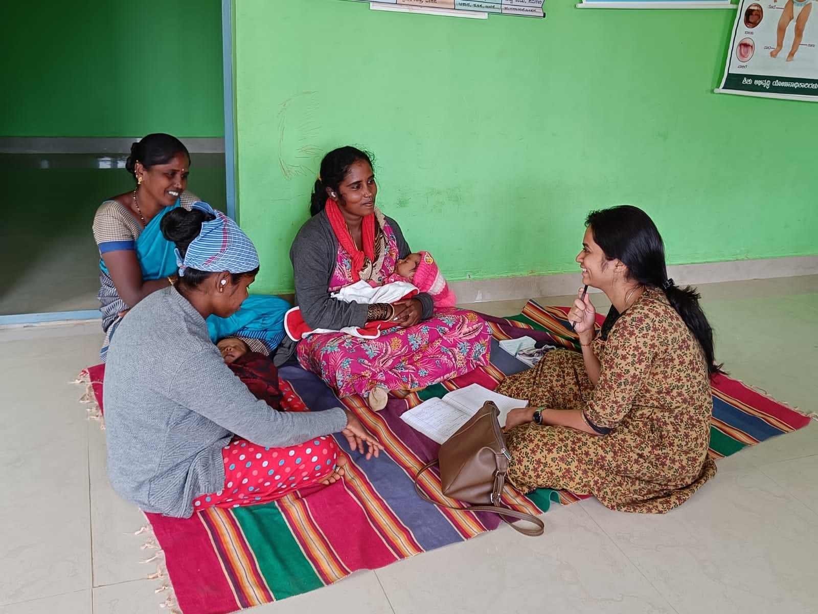
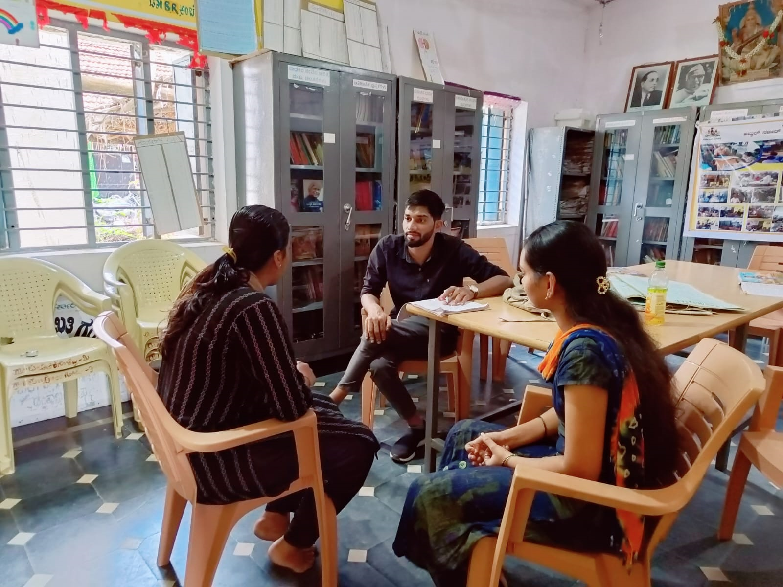
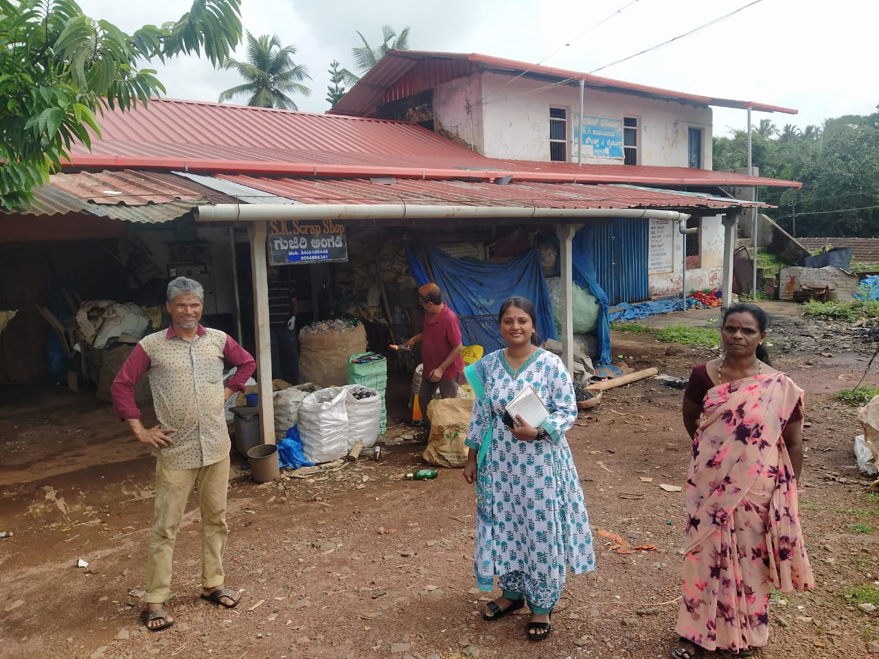
Field Visits – A Critical Learning Tool for the Fellows
Crèches
More than 90 Combined Field work days (3 Fellows plus State Lead) in 5.5 months (does not include the six weeks of election code of conduct)
Our aim: all should have knowledge of all the projects in our portfolio
Each may have a main project and 1-2 other secondary projects at a time
Libraries
SWM

Slide 3
Field Visits – A Critical Learning Tool for the Fellows
The team visited:
21 Districts | 39 Taluks |67 Gram Panchayats
35 SWM Teams
16 Crèches
51 Libraries

Slide 4
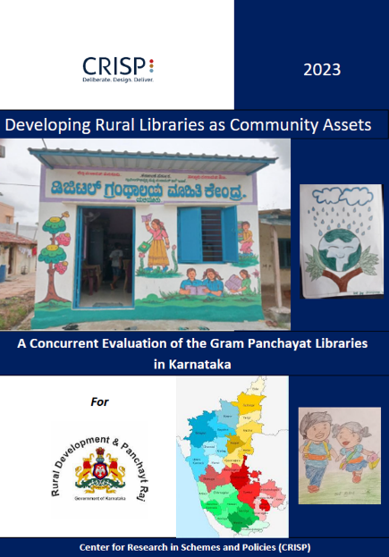
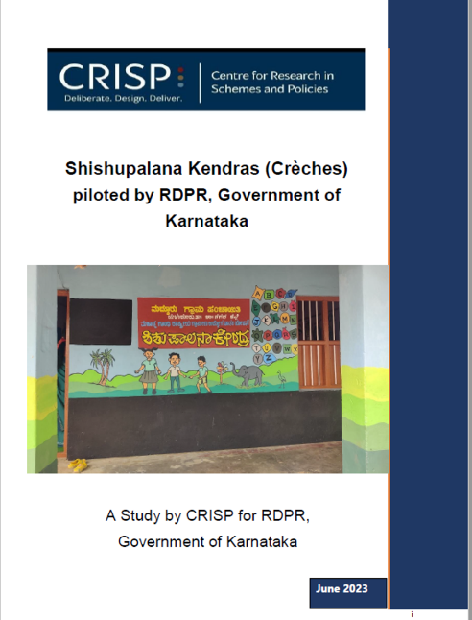
Field Visits – A Critical Learning Tool for the Fellows
Learnings from the field are reflected in the reports produced by the team
RDPR is operationalizing some of the recommendations based on field level findings
Now commissioned other smaller evaluation projects

Slide 5
Gratitude
The Karnataka Team thanks our mentors for their continued and in-depth engagement with the team on all aspects of our work
They are available not just on the weekly meetings, but any time we want to run an idea or a situation by them for feedback and advice.
Weekly Meetings / Mentoring

Slide 6
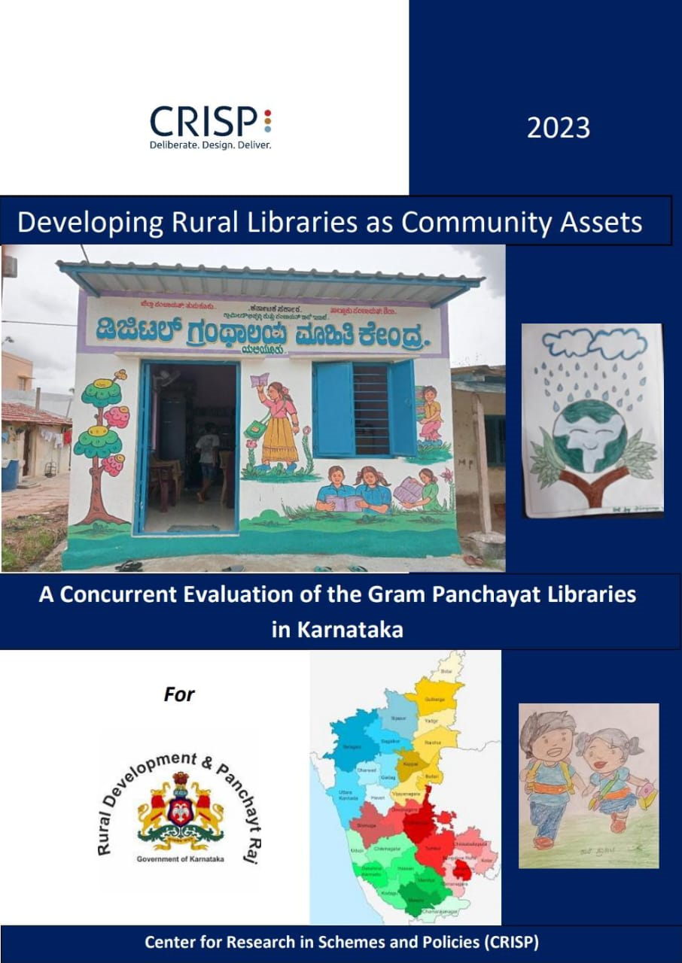
Evaluation of Rural Libraries
Submitted the Concurrent Evaluation report in July.
Discussed with Commissioner
Signs of implementing recommendations
NGO tie ups being planned for some key recommendations like:
additional libraries in smaller villages to mitigate distance and transport issues
librarian upskilling and,
replenishment of books.
Link to Report

Slide 7
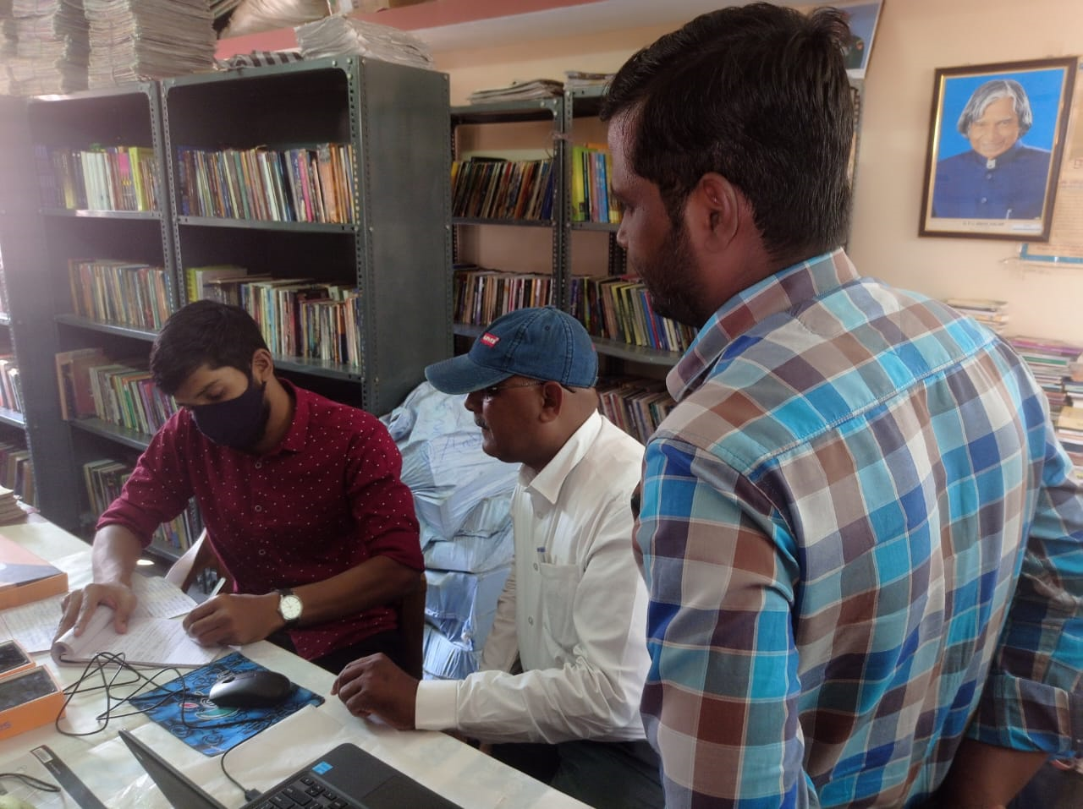
Evaluation of Rural Libraries
Larger Outcome evaluation (mentioned in the MoU) is in the works.
Theory of Change and Logframe submitted for internal review
Draft Questionnaire undergoing revisions.
Concurrent evaluation of Digital Libraries (implemented by Sikshana Foundation with Dell Foundation Grant)
We are currently working on this – focus is on field level insights to inform scale up

Slide 8
Evaluation of NREGA Crèches
RDPR launched Pilot Crèches in 2022 (two in each district)
Field insights on how the pilot crèches were functioning.
Not all were functioning; we visited 16 and reported to the department in June
The findings will inform the current roll out of 4000 crèches (in four phases).
Link to Report

Slide 9
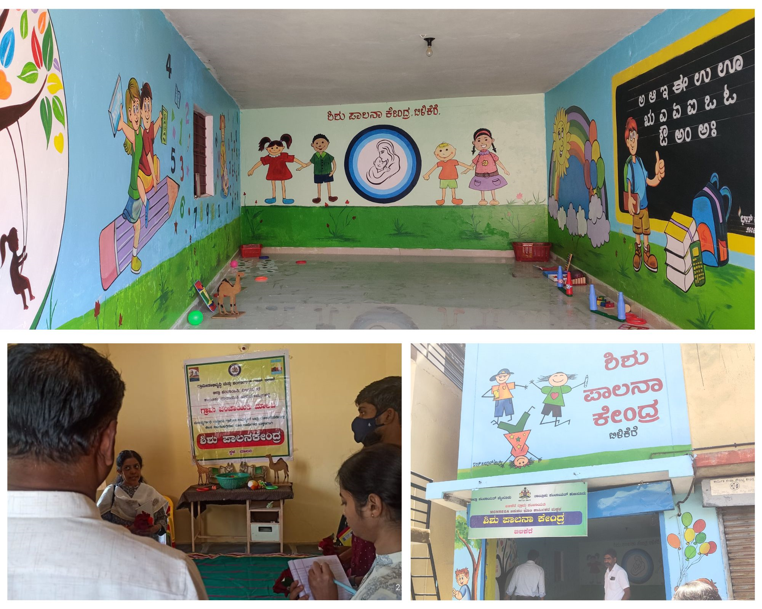
Evaluation of NREGA Crèches – Baseline Study
This year, RDPR hopes to roll out 4000 crèches in rural areas
Baseline study in a sample of the Gram Panchayats slated for the first phase of roll out shortly
Theory of Change and Questionnaire are ready and have been discussed internally and with the Commissioner

Slide 10
Evaluation of NREGA Crèches – Baseline Study
Sampling procedures
The first thousand crèches will be in the Kalyana Karnataka region
Appropriate sampling procedures planned
Mode of data collection – Potential to use students from RDPR University, Gadag
Ideal to do two districts first, to enable course corrections if required. Still being discussed

Slide 11
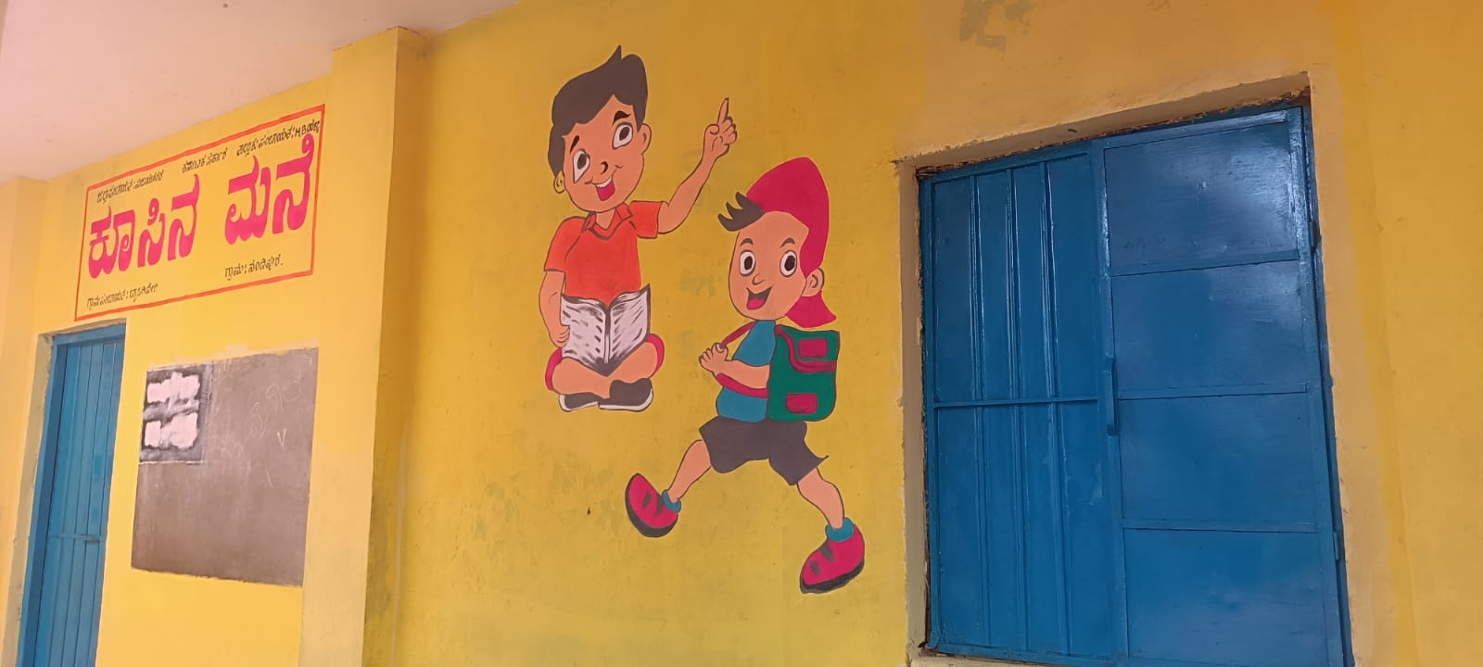
CRISP Involvement:
If department asks for monitoring, team can help with continuous monitoring and reporting on implementation (will need dedicated resources)
Support the department in roll out – Review of GO and circulars
Recommend and implement digital record keeping at the crèche level.
Evaluation of NREGA Crèches – Implementation

Slide 12
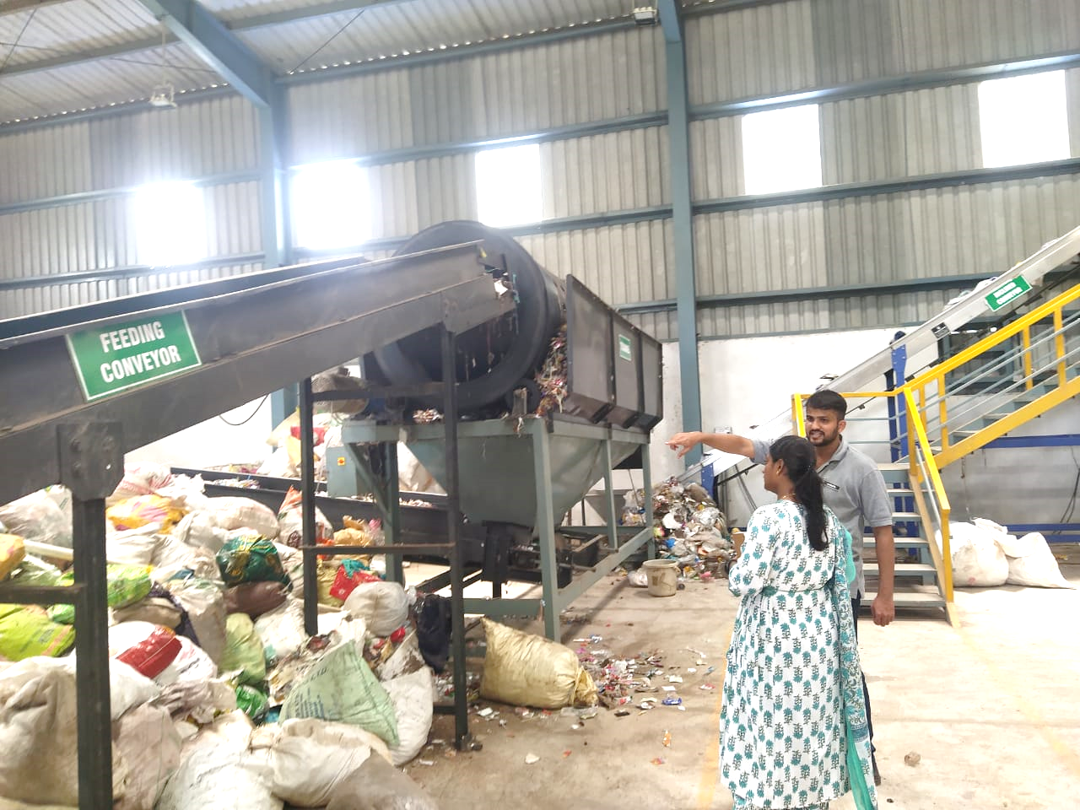
Solid Waste Management (SWM)
SHG - GP Convergence
By far, the most challenging project on our list
Extensive field visits to study SWM through SHGs
Key observations relate to:
Whether the initiative enables an enterprise or entrepreneur model for the SHG women
Whether they are able to monetize the waste collected
Whether citizens will pay for the waste collection service
Infrastructure needed for waste processing

Slide 13
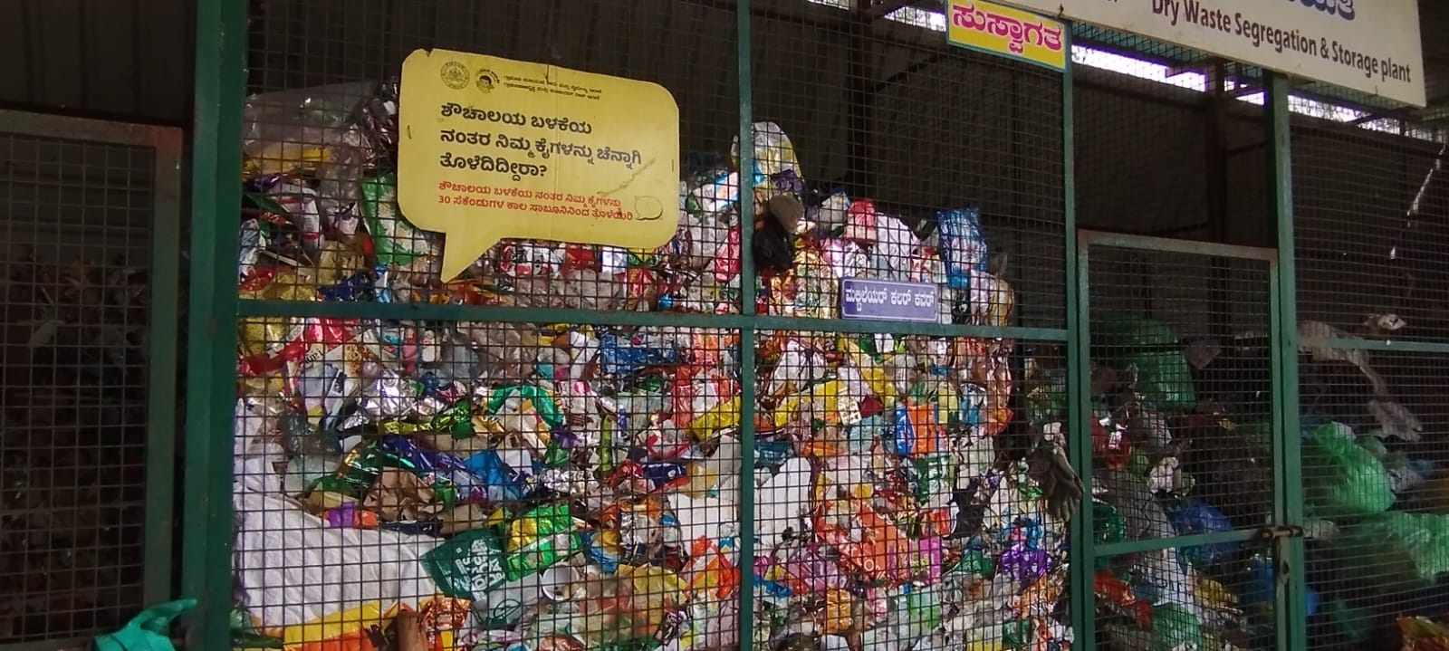
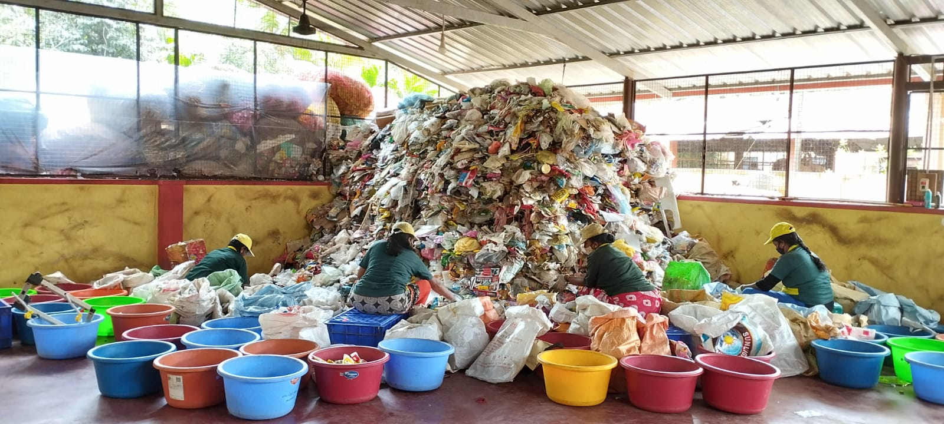
Solid Waste Management (SWM)
SHG - GP Convergence
In the next six months:
Team will select 2-3 “Resource Clusters” – GPs where some interventions can be tried out:
Work with GPs for formally authorizing women to collect user fees. Achieve higher user fee collection
Mapping of local scrap dealers for decentralized management of waste
Explore additional income-generating activities for women around waste management

Slide 14
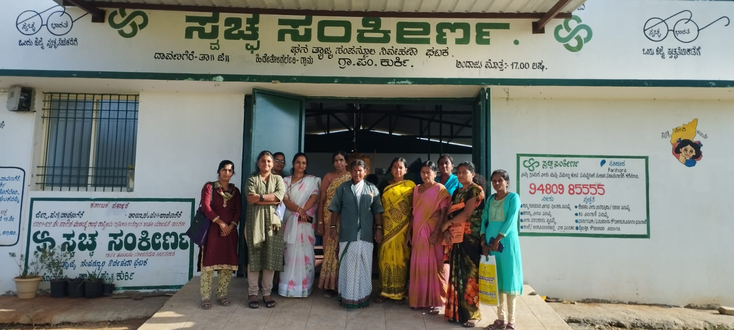
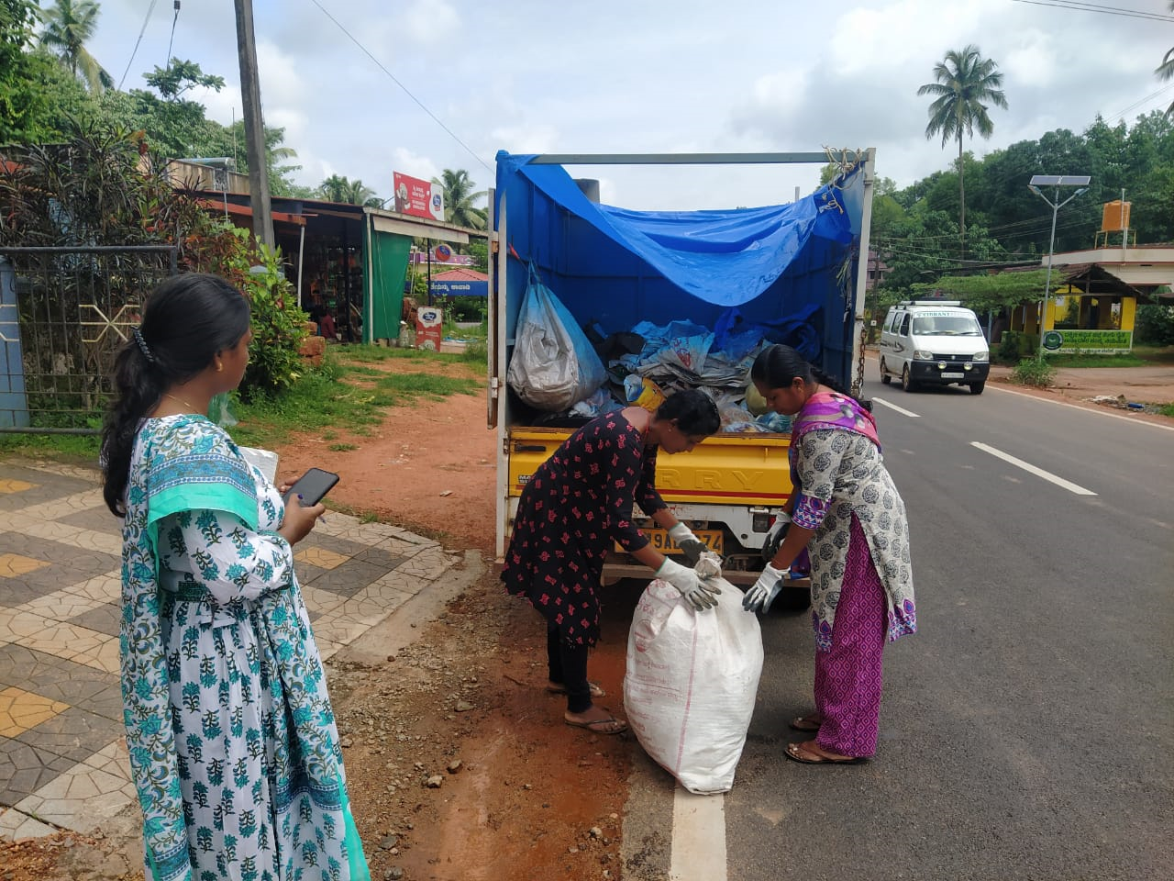
Solid Waste Management (SWM)
SHG - GP Convergence
In the next six months:
Nurture leadership among the women involved in SWM
Recommend a Supervisor role within the SWM group
Develop templates for record-keeping and train the women to use them
Amount of user fees collected, by month and user
Amount of waste collected
Amount of waste sold; earnings
Explore digital record maintenance through an app
Greater engagement with public for sensitization on proper handling of waste

Slide 15
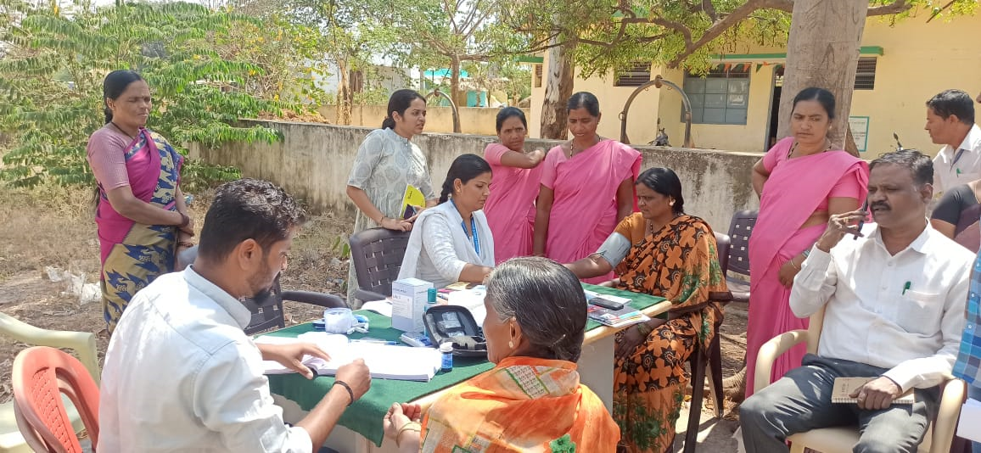
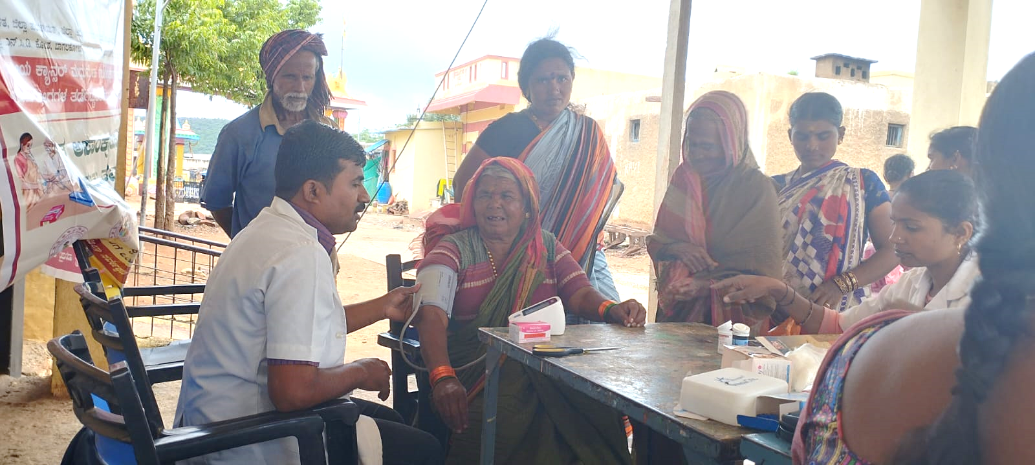
Strengthening Grama Arogya
Formerly known as Gram Panchayat Arogya Amrutha Abhiyana (GPAAA)
Grama Arogya focus – NCD testing, TB screening, Anaemia screening, mental health counselling and awareness raising on child marriage and menstrual hygiene
GP Health management kits distributed, health camps are conducted

Slide 16
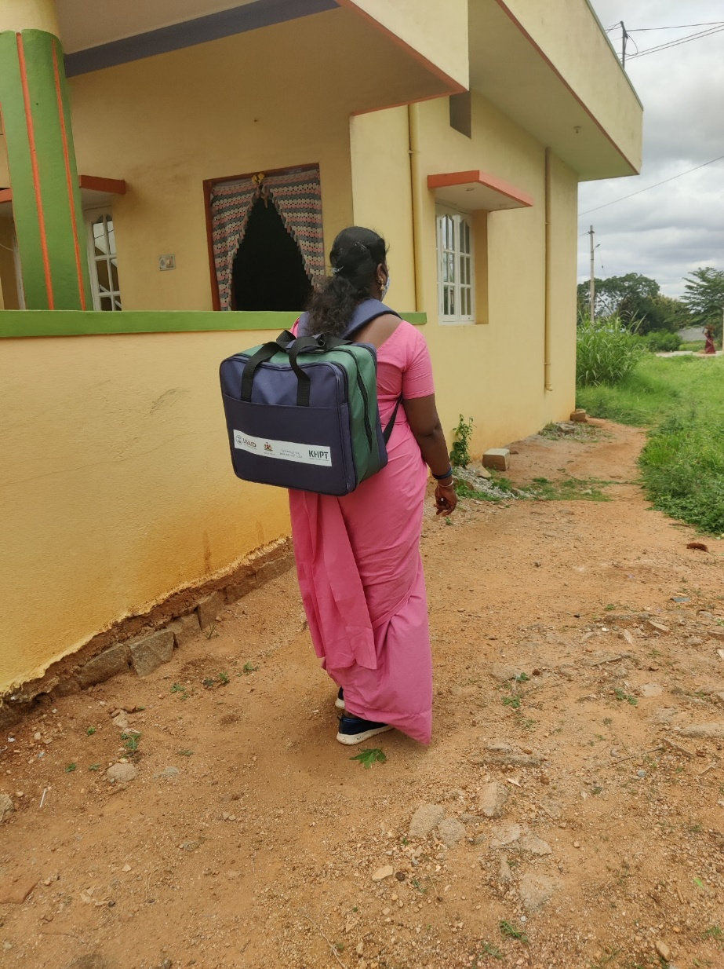
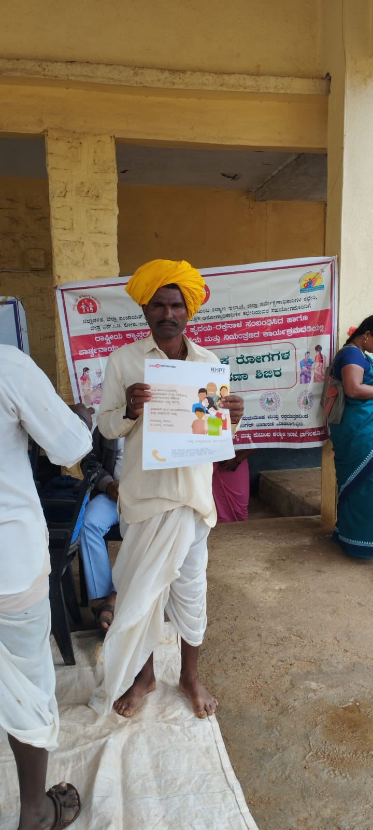
Strengthening Grama Arogya
Team focus:
Scoping visits to Grama Arogya camps in Bagalkote and Dakshin Kannada districts
To study the processes, data management, extent of GP involvement, coordination between GP and Health providers at the GP level
User interaction to probe improvement, if any in the health-seeking behaviour of the people

Slide 17
Strengthening Grama Arogya
Next steps:
More visits to camps – sample to cover more districts
Interview camp attendees to study health-seeking behaviour / follow up after camp
Interview of PDOs and CHOs
Data analysis
Preparation of concurrent evaluation report

Slide 18
Strengthening the Social Audit Unit
External team of experts commissioned by CRISP to conduct an evaluation of the Social Audit Unit
Test audit in two Gram Panchayats to assess quality of Social Audits in Karnataka
Final Report with findings from the Test Audits submitted to the government
(Prepared by external team)

Slide 19
Proposed: 51 Fellows will be recruited for deployment at Taluk level in the Kalyana Karnataka Region.
With mentors’ guidance and inputs, prepared a concept note on the Commissioner’s request.
Commissioner has called for a meeting to brainstorm and lay a framework for the Fellowship
CRISP will assist the government with recruitment of Fellows and program management through a PMU.
Proposed: CM’s Rural Development Fellowship

Slide 20
Centre for Child Responsive Local Governance
Our team wrote the proposal to UNICEF and prepared the budget
Prepared Job Descriptions for the Consultants and Young Professionals that were hired for the Centre
Created the Results Matrix
Put in sports as an important indicator of child responsive governance
Other projects / tasks assigned by RDPR

Slide 21
Proposals for Funding for Rural Libraries
Other projects / tasks assigned by RDPR
Team members wrote 6-8 proposals for funding of Rural Libraries
Preparatory work
Research
Budgets
Revisions based on feedback
Assisted the Minister’s office to develop CSR proposals for funding

Slide 22
Document Preparation
Other projects / tasks assigned by RDPR
Team members participate in:
Government Order Preparation
1 or 2-day long “WriteShops” for various documents and project specifications
Coordination with NGOs assisting the Government with the above

Slide 23
Review of NGO Proposals to the Department
Other projects / tasks assigned by RDPR
Commissioner asks CRISP to evaluate NGO proposals to the Department for various initiatives:
Assess service offered by the NGO
Evaluate the proposal on various parameters
Assist the department in discussions with the NGO on implementation

Slide 24
We started an excel sheet to document tasks given to us by the Commissioner’s office or the ACS.

